Slide 1
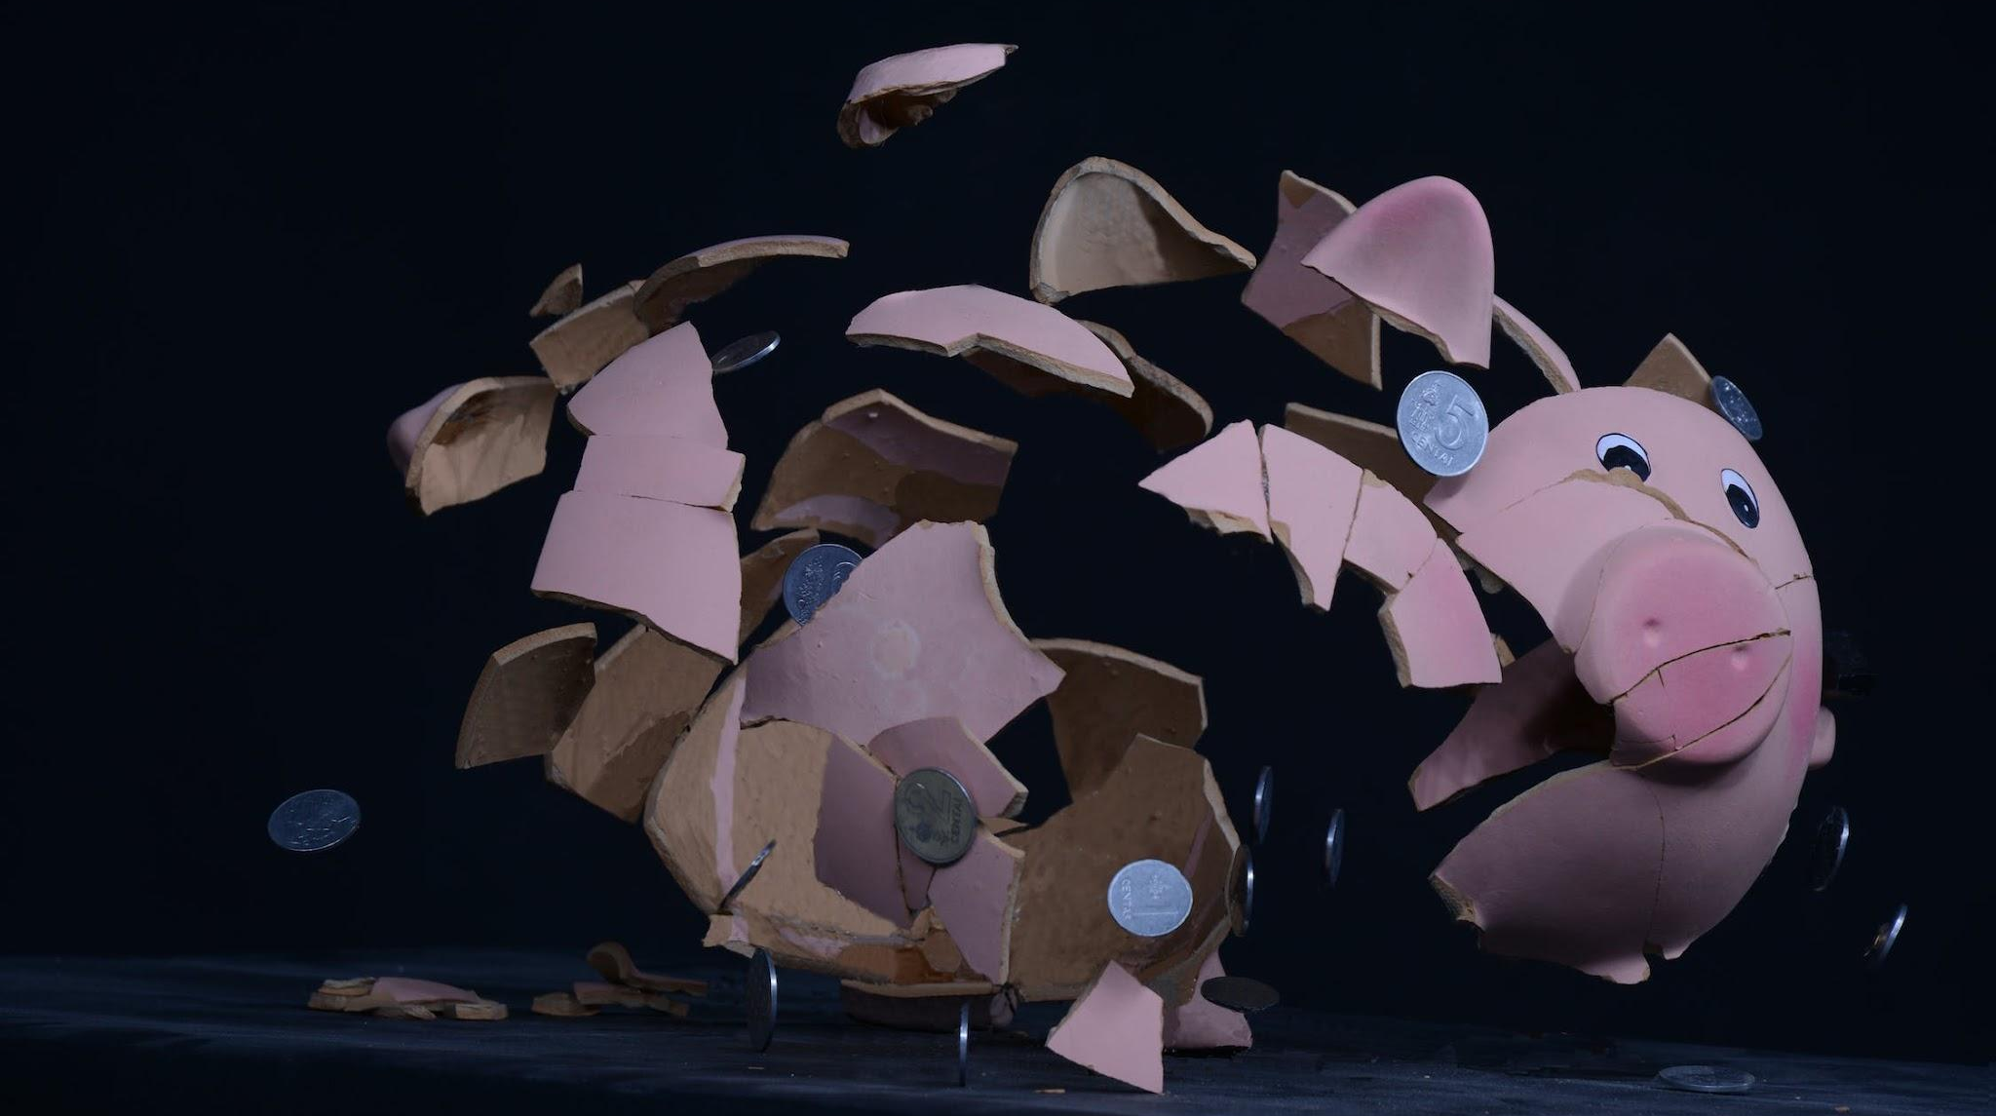

Affordability
Across the App
(acp-confidential-cadoc)
Kelly Peterson, UXR

Slide 2

Agenda
How should we think about affordability?
How do Cx feel about the cost of DoorDash?
How can we add value?
What are we doing today and what’s next?
Discussion and Q&A
Jump in with any clarifying questions, comments, or reach out to @kelly.peterson

Slide 3

Objectives for today
Understand how Cx think about value & affordability in Rx and NV
Hear about two initiatives DoorDash is testing today
Identify future affordability challenges
Discuss how we can keep moving forward

Slide 4
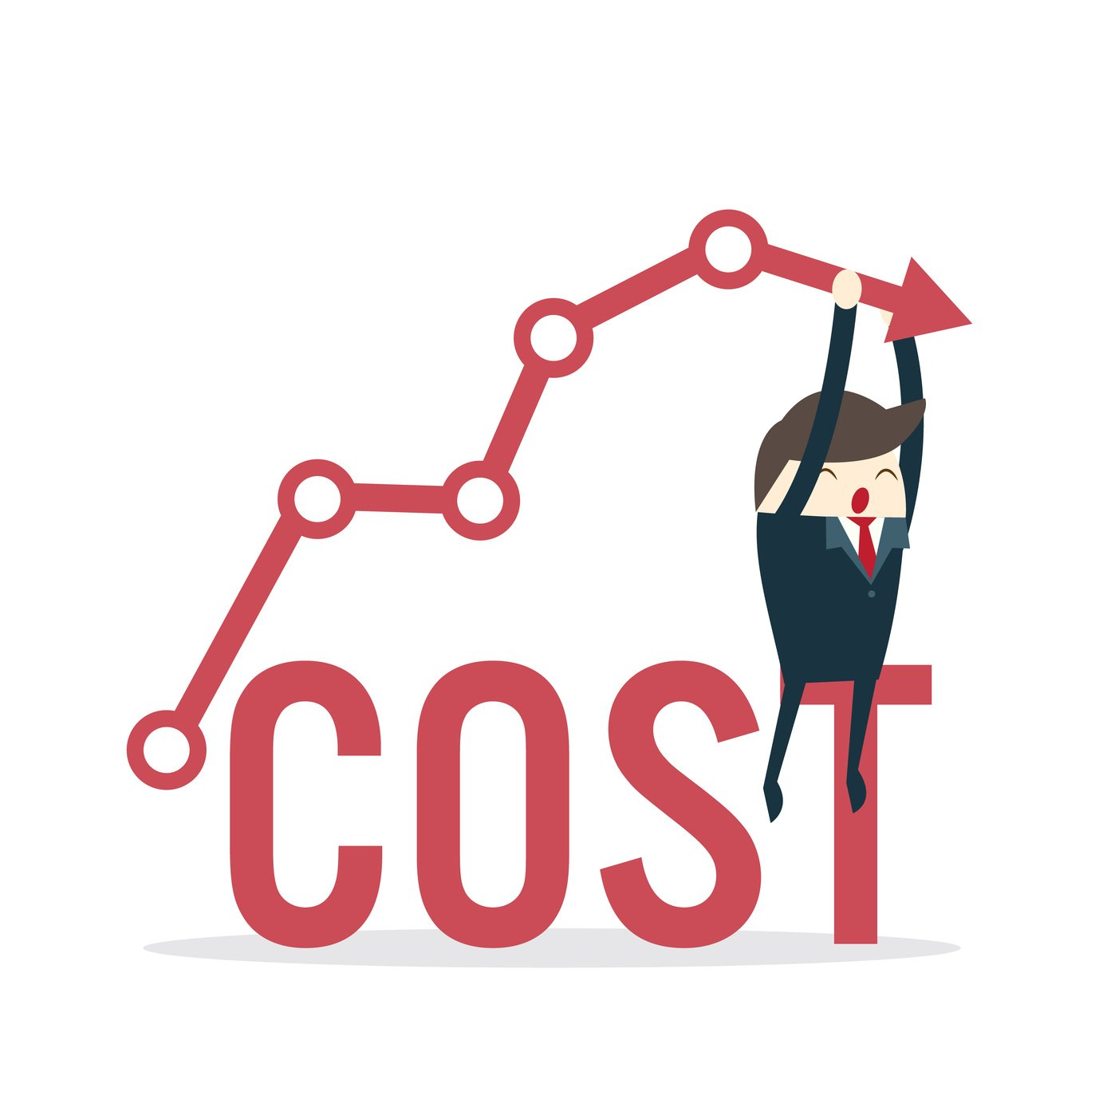
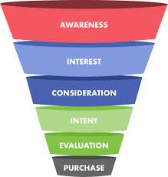
Cost is a top barrier to adoption across the app
“I would order more if it didn’t cost so much”
There is a missed opportunity to increase MAUs & DashPass subscribers when we lose Cx at the top of the funnel

Slide 5
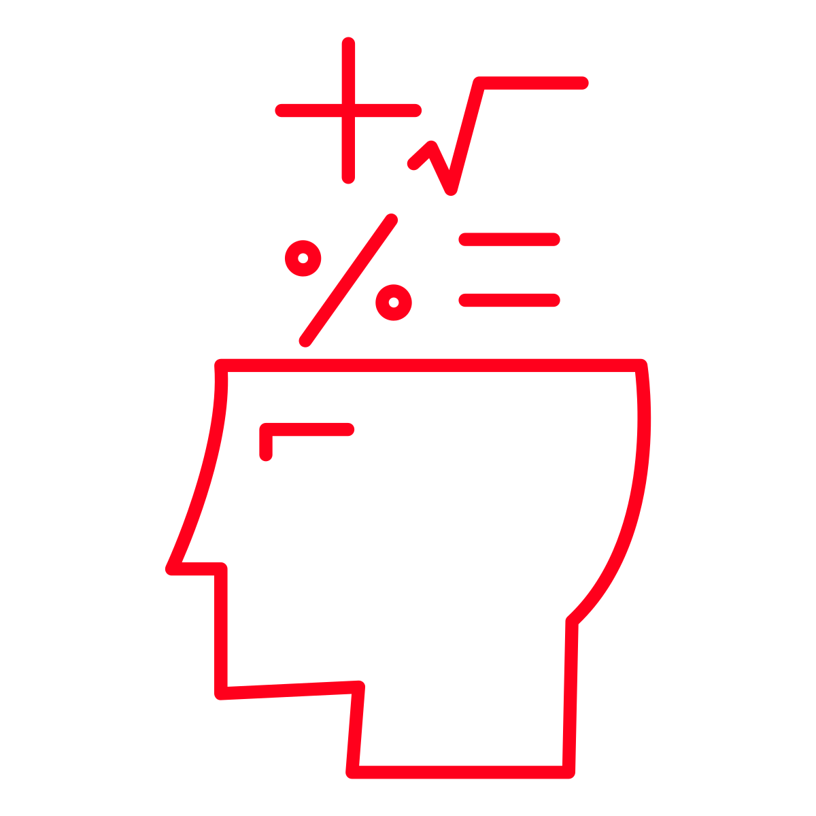


We have a wealth of information available to us to understand affordability
Occasional Cx Churn & Retention (Sept 22)
NV Perceived Value and Affordability (May 22)
Additional Inputs
Occasional Cx place 2 or fewer orders a month on average. Why are occasional Cx churning & how can we resurrect them and keep them happy long term?
What is the mental math that Cx must complete when shopping on DoorDash for Grocery & Retail?
Understanding across multiple research workstreams by UXR team
Report: Churned Users
Report: Ramp Up/Ramp Down
Report: Very Churned & Recently Resurrected
Report: Understanding frequent Cx visitor drop off
Report: Merchant Needs and Pain points
Report: 1P, 3P, Pickup, Delivery
Phase 1: Diary Study with a large & small shopping trip over 6 days (n=27)
Phase 2: Follow-up 1:1 moderated interviews (n=11)
Phase 1: Survey (n=668)
Phase 2: Follow-up 1:1 moderated interviews (n=5)
Participants are non-Dashpass, occasional Cx (2 orders or less) and churned (no orders L56)
Full report
Included a mix of 1st time NV shoppers and existing NV Cx. Balanced for geography, age and gender.
Full report

Slide 6

How should we think a about affordability?

Slide 7

Affordability is not just about cost; it’s about value
When making a purchase decision, the value must be equal to or outweigh the cost. Cx will look at all factors to ensure that purchasing through DoorDash is a better option than the alternative
Cost
Value
Does the price feel right?
What are the fees?
How much will I have to tip?
What is the total?
Will this save me time/effort?
Do I receive any additional benefits?
Do I have loyalty elsewhere?
Will the quality be worth the cost?
Cost / Value = Affordability

Slide 8
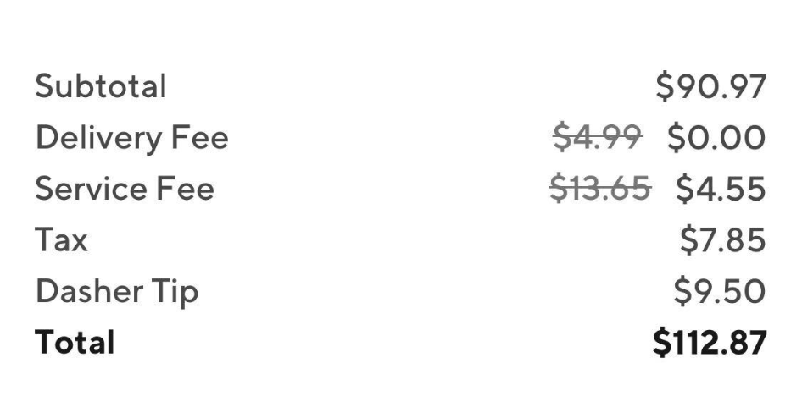

At the end of the day, Cx need the total cost to make sense…
How DoorDash thinks about cost:
How Cx think about cost:
$112.87

Slide 9
…across the entire DoorDash app
How DoorDash thinks about affordability:
How Cx think about affordability:
“I want to pay as little as possible every time…”
Rx
“Thing should be consistent and make sense, that is the most fair”
CnGA
Retail

Slide 10
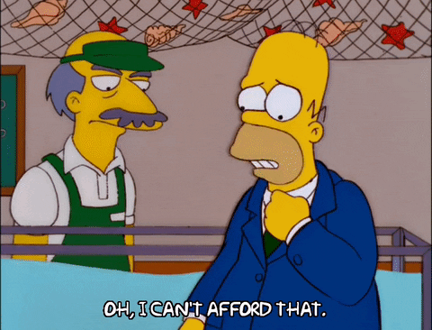
How do Cx feel about the cost of DoorDash?

Slide 11
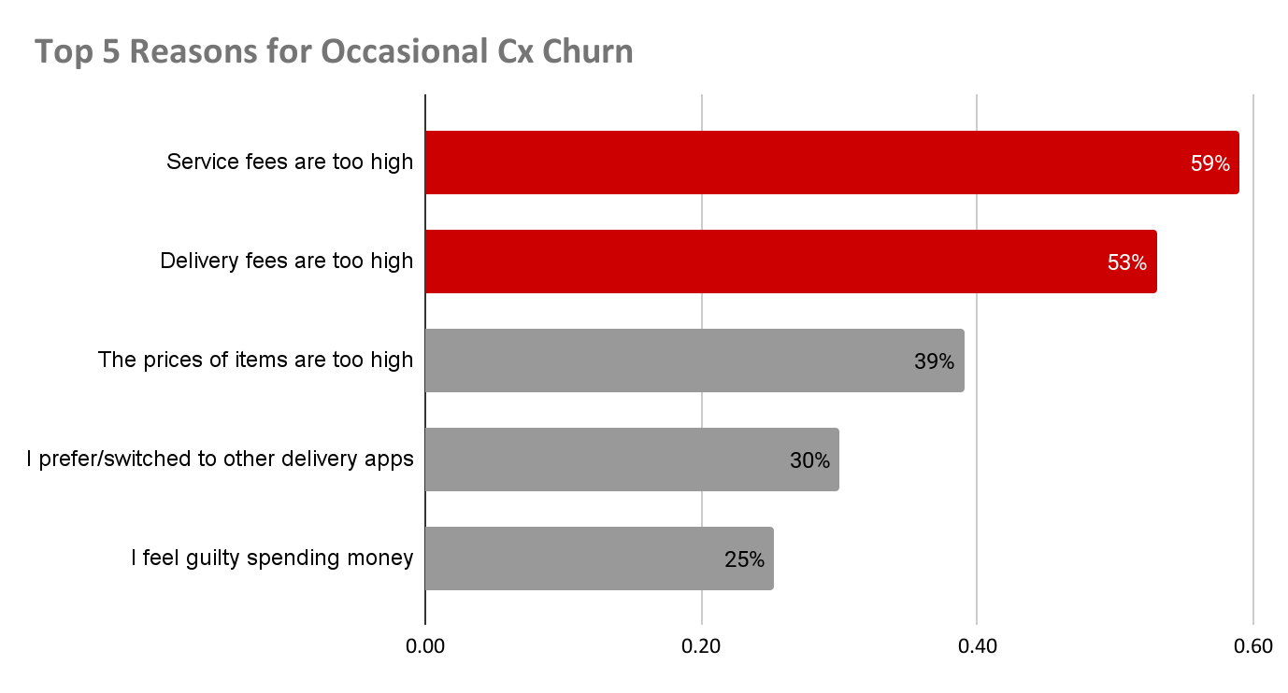

Cx view fees as a necessary evil, however fees drive “sticker shock”
Participating Cx want to know more about Delivery Fees vs. Service Fees
Base: n=668 Churned Occasional Cx
Which of the following, if any, would encourage you to return to DoorDash?
Source

Slide 12


Most Cx expressed preference for the ease of flat fees
Overall Cx acknowledge they have to pay a premium for convenience.
Cx feel the amount of each individual fee is fair, however, when added to total and tip, it becomes too much
Some Cx feel fees should be a sliding scale, as you spend more money the proportion should go down.
However they also note that fees feel most burdensome on smaller orders
Source

Slide 13

After fees, item prices are the #2 barrier to conversion
39%
Of Occasional Cx have churned from DoorDash because “the prices of items are too high”
23%
Of potential grocery Cx did not convert because the “prices seem higher”*
Base: n=668 Churned Occasional Cx
Which of the following, if any, would encourage you to return to DoorDash?
*Base: n=192 Non-Converted Grocery Cx
Which of the following best describes why you haven’t used DoorDash for groceries?
Source, Source

Slide 14


Most Cx are aware of inflation
Once experienced, they assume it happens everywhere on the app, at a similar rate
Source, Source

Slide 15
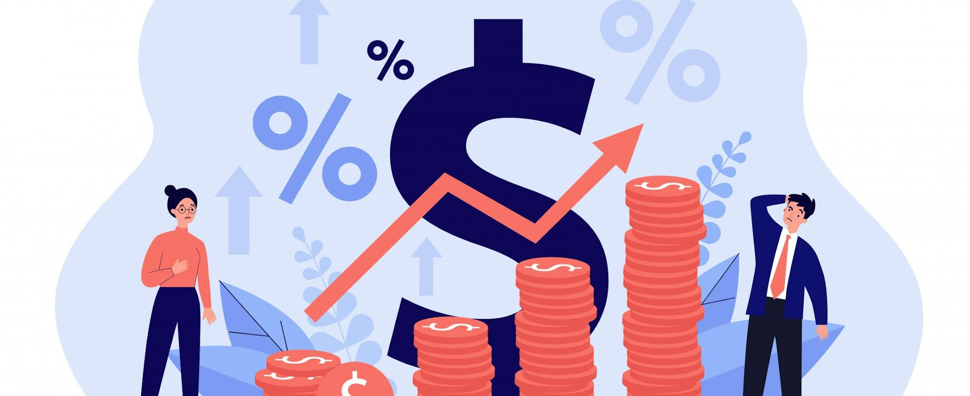
Most Mx do not want to inflate; high commissions contribute to price inflation
Unmanaged + small Mx are left with very high commission rates (~25-30%) that makes DD unprofitable for them
Source

Slide 16



Capped fees and in-store prices are top ways to get churned Cx back
Top reasons for churned occasional Cx to return to DoorDash:
Guarantees fees no more than $3
62%
Guarantees in-store prices
55%
Discounted $$ on next order
52%
Grocery Cx indicate that fees beyond $7-$9 start to feel like a tipping point where it is too much
No delivery fees for a limited time
51%
BOGO meal promotion
46%
Base: n=668 Churned Occasional Cx
What are the top reasons why you haven’t order from DoorDash in a while?
Source
Source

Slide 17
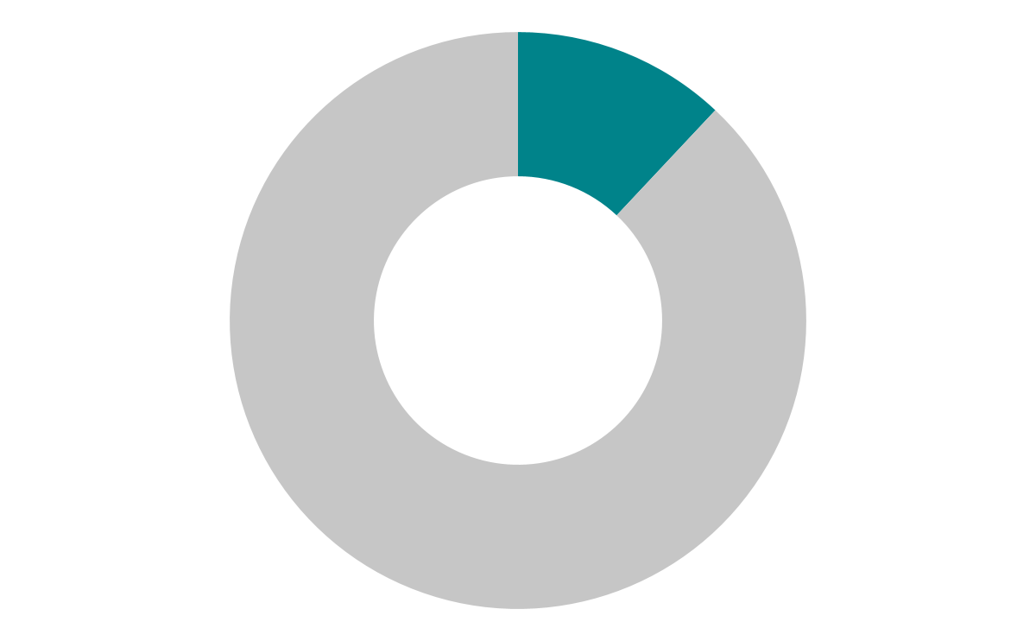
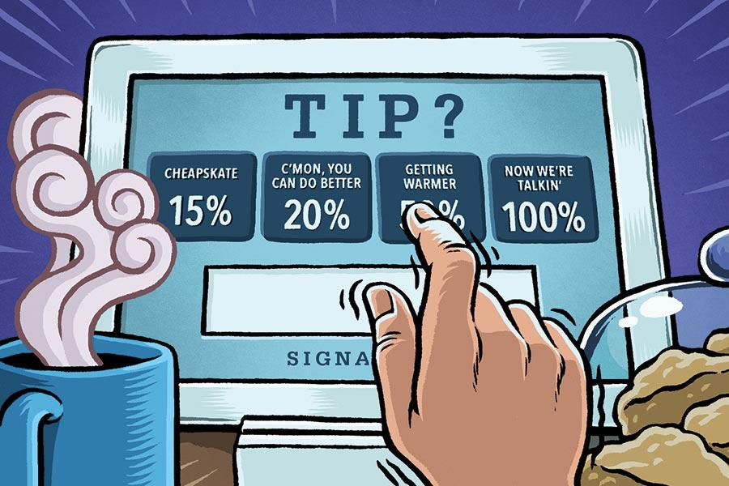
Tipping is not the problem, however some Cx are upset by separate tipping screen
Only 12% of occasional Cx indicated that they churned from DoorDash because they don’t like having to tip.
Base: n=668 Churned Occasional Cx
What are the top reasons why you haven’t order from DoorDash in a while?
Source, Source

Slide 18
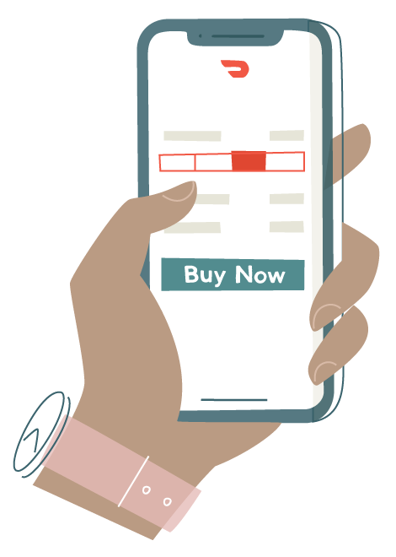
Once Cx have a sense of the total cost, they often lean on coupons/deals to make a final purchase decision
Some go as far as to price-compare side-by-side, between different third-party channels, as well as between first- and third-party options. Some Cx do so by taking screenshots of different apps
Source

Slide 19
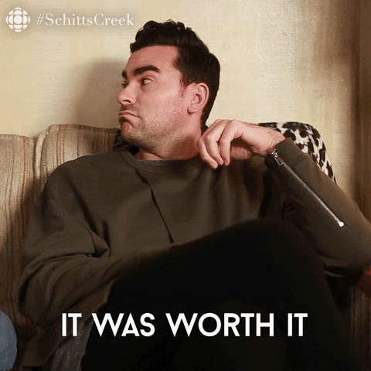
How can we add value?

Slide 20
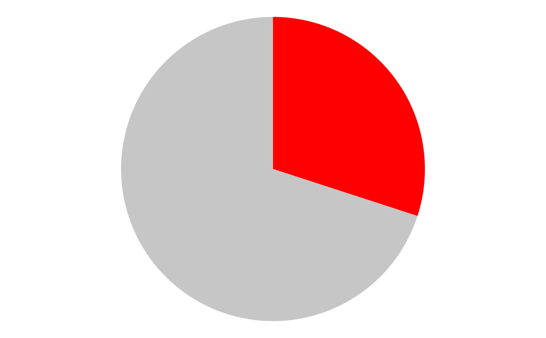



While DashPass is our top lever for affordability; the competition is also using a similar approach
Those Churned Occasional Cx that previously had DashPass are significantly more likely to have another subscription service
These Churned Occasional Cx that previously had DashPass Cx tell us they expected DoorDash to discover the best deals at the best restaurants that are only available to them.
#1
#2
30% of Churned occasional Cx had DashPass in the past
#3
Additional research coming on overall DashPass churn in Q4 2022
Base: n=668 Churned Occasional Cx
Have you ever considered signing up for DoorDash DashPass?
Which, if any, of the following on-demand delivery apps do you currently have a subscription with (or do you use another person’s subscription for)?
Source

Slide 21
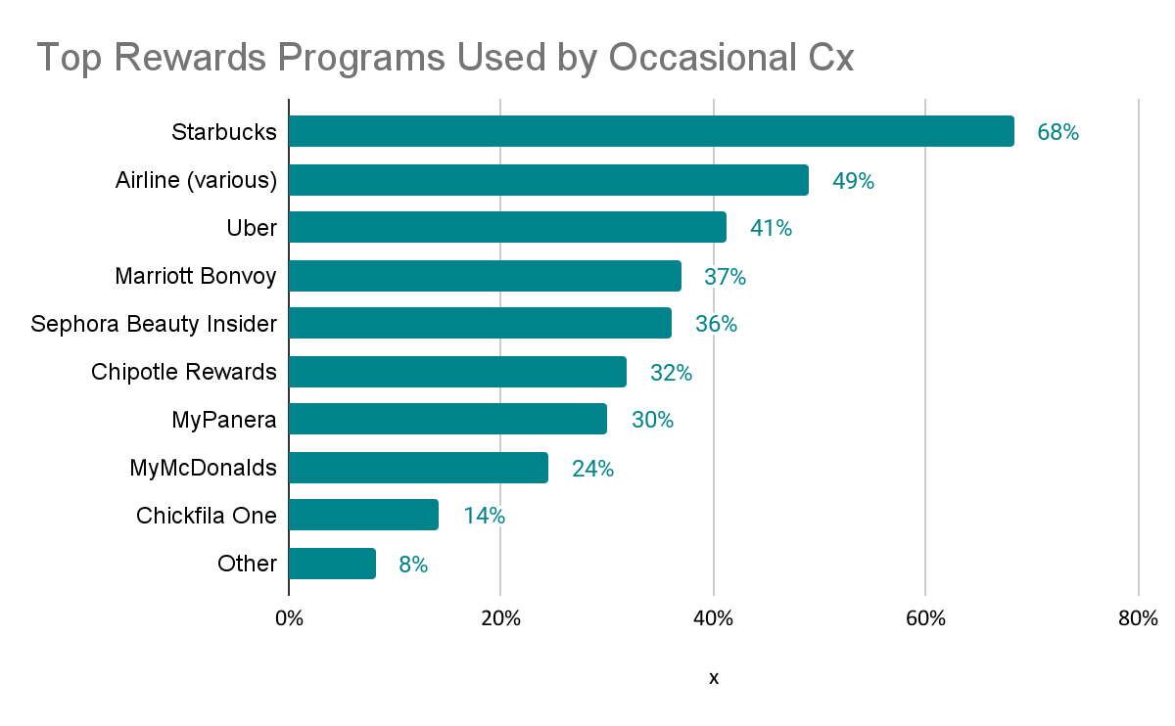
Most Cx express some interest in rewards or loyalty programs
Cx are quick to sign up for free, point-based reward programs but not committed to them
They are generally skeptical about program’s value and therefore prefer programs with double rewards
A points system is of interest for DoorDash but needs to be seamless and automated to truly impact purchasing behaviors
Base: n=668 Churned Occasional Cx
Which, if any, of the following loyalty or rewards programs do you currently use?
Source, Source

Slide 22



However there is still a lot to solve for!
SELECTION
QUALITY
EXPERIENCE
Cuisine coverage
Dietary needs
New & exciting
Timing
Accuracy
Consistency
Customer service
Supporting local
Engaging others

Slide 23
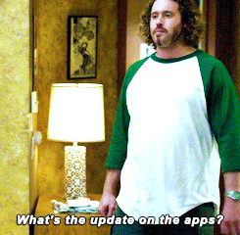
What are we doing today & what’s next?

Slide 24

We are trying a lot decrease costs….
Ongoing/planned experiments (list is not exhaustive):
Homepage takeover
Neighborhood Delivery
Fee-based ablation
Go Big
Win Back Pricing
Epic1
Epic2
Grocery Golden Market
Taste of DashPass

Slide 25
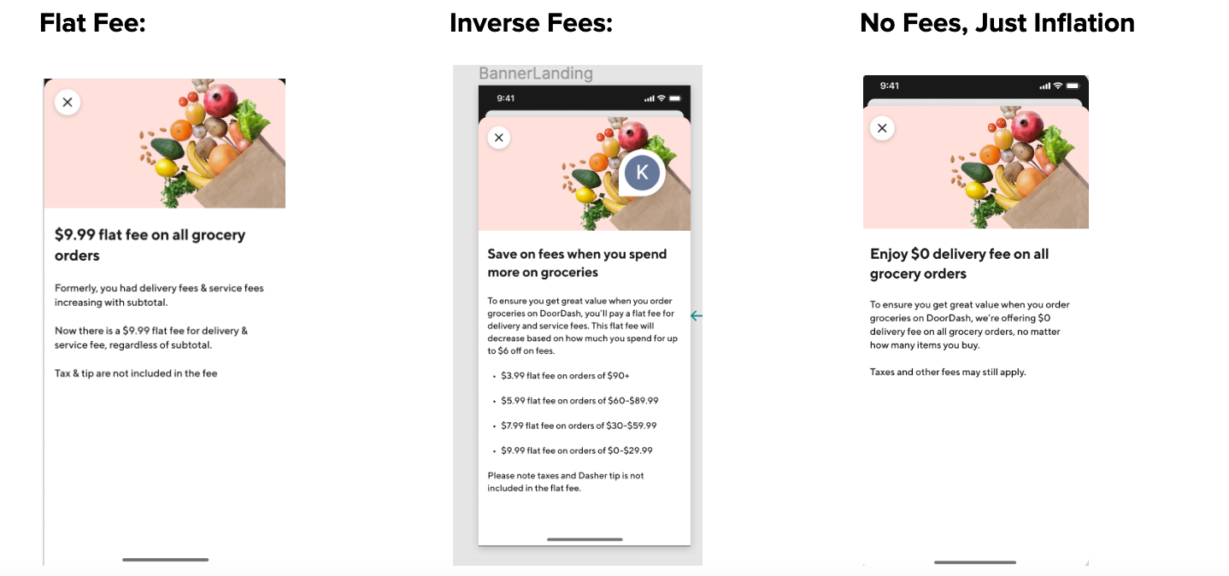
Grocery Golden Market Experiment: Phase 1
Flat Fee test with a $9.99 fee performed the best (in terms of expected GMV).
The next step is to run more A/B tests with the goal of choosing the best performing flat fee that is VP sustainable and validating the results.

Slide 26
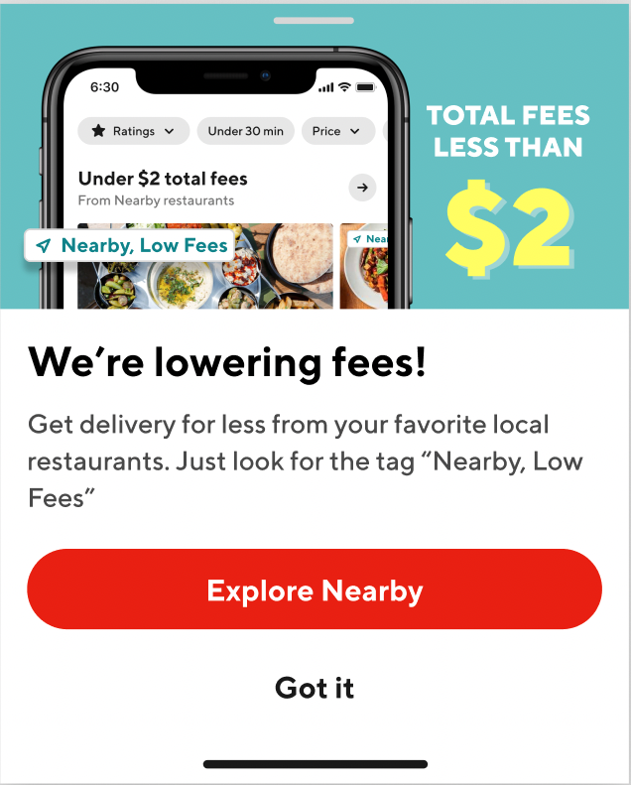
Occasional Cx Golden Market: Epic1
Experiment is currently ongoing for another week.
There is also ongoing research with Cx to opportunities to improve, understand impact and potential long term impact.

Slide 27

…but what we will do for value?
Value
Cost

Slide 28
Recommendation Summary
1.
Provide “flat fees”(excluding tip).
Cx think about “overall cost” rather than individual fees when placing an order. Making it easier to calculate may help to improve perceived affordability.
4.
Limit price inflation as much as possible
Work with Mx to help reduce commissions allowing for reduction in inflation; communicate in-store prices where possible and minimize inflation across all categories, build towards in-store prices everywhere.
2.
Provide fee caps promises.
Cx want to know that they will not receive an unreasonable amount of price inflation + fees. Ensure Cx that there will be limitations (e.g. fees no more than 10% of your total order)
5.
Continue to explore rewards, with caution
While Cx express interest in rewards programs they will only feel the value of it with DoorDash if it is truly a “set it and forget it” format that highlights savings for them
3.
Build more entry points for discovery
Highlight affordability throughout the Cx journey beyond the homepage (e.g. within cuisine and Rx pages)
6.
Build a stronger focus on value
Fees, inflation, tipping and pricing will continue to be a challenge for many years to come. We can only win if we are able to balance with selection quality and experience

Slide 29
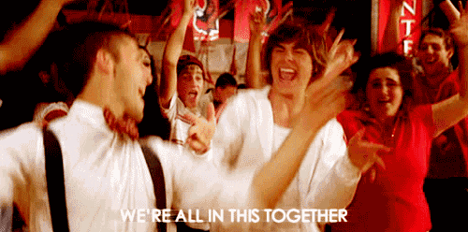
We can do this!

